Slide 1
Growth of Functions
&
Asymptotic Notations

Slide 2
Algorithm running time
  Exact running time can be computed for small problem size (small n)
  Asymptotic performance can be found for large n where multiplication constants and lower-order terms of the exact running time are dominated.
Asymptotic performance of algorithm
  How the running time of an algorithm increases with the size of the input in the limit, as the size of the input increases without bound

Slide 3
Asymptotic Notation
Θ-notation
For function g(n), we define Θ(g(n)), big-Theta of n, as:
Θ(g(n)) = { f(n) :
∃ positive constants c₁, c₂, and n_{0,} such that
0 ≤ c₁g(n) ≤ f(n) ≤ c₂g(n) ∀n ≥ n0 }
g(n) is an asymptotically tight bound for f(n).

Slide 4
Example
1/2n²-3n=Θ(n²) ???
c₁, c₂, n₀ ???

Slide 5
O-notation
For function g(n), we define O(g(n)), big-Oh of n, as:
O(g(n)) = { f(n) :
∃ positive constants c and n_{0,} such that
0 ≤ f(n) ≤ c g(n) ∀n ≥ n0 }
g(n) is an asymptotically upper bound on f(n).
(Worst Case)

Slide 6
Example
an+b=O(n²) ???
c, n₀ ???

Slide 7
Ω-notation
For function g(n), we define Ω(g(n)), big-Omega of n, as:
Ω(g(n)) = { f(n) :
∃ positive constants c and n_{0,} such that
0 ≤ c g(n) ≤ f(n) ∀n ≥ n0 }
g(n) is an asymptotically lower bound for f(n).
(Best Case)

Slide 8
Example
√n=Ω(lg n) ???
c, n₀ ???

Slide 9



Relations between Θ, Ω, O
Theorem :
For any two functions g(n) and f(n),
f(n) = Θ(g(n)) iff
f(n) = O(g(n)) and f(n) = Ω(g(n)).

Slide 10
Asymptotic notations in equation and inequalities
2n²+3n+1 = 2n²+ Θ(n)
  there is some function f(n) = Θ(n) such that 2n²+3n+1 = 2n² + f(n) ∀ n
2n²+ Θ(n) = Θ(n²)
  for any function f(n) = Θ(n) there is some function g(n)= Θ(n²) such that 2n² + f(n) = g(n) ∀ n.

Slide 11
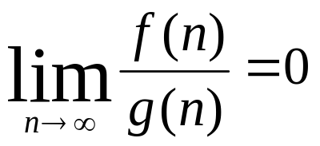
o-notation
For function g(n), we define o(g(n)), little-oh of n, as:
o(g(n)) = { f(n) :
for any positive constants c > 0 ∃ a constant n₀ > 0 such that
0 ≤ f(n) ≤ cg(n) ∀n ≥ n0 }
g(n) is not an asymptotically tight upper bound for f(n).
f(n) becomes insignificant relative to g(n) as n approaches infinity:

Slide 12
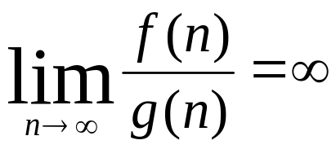
ω-notation
For function g(n), we define ω(g(n)), little-omega of n, as:
ω(g(n)) = { f(n) :
for any positive constants c > 0 ∃ a constant n₀ > 0 such that
0 ≤ cg(n) ≤ f(n) ∀n ≥ n0 }
g(n) is not an asymptotically tight lower bound for f(n).
f(n) becomes arbitrarily large relative to g(n) as n approaches infinity:

Slide 13
Comparison of Functions
Transitivity
f(n) = Θ(g(n)) & g(n) = Θ(h(n)) ⇒ f(n) = Θ(h(n))
f(n) = O(g(n)) & g(n) = O(h(n)) ⇒ f(n) = O(h(n))
f(n) = Ω(g(n)) & g(n) = Ω(h(n)) ⇒ f(n) = Ω(h(n))
f(n) = o (g(n)) & g(n) = o (h(n)) ⇒ f(n) = o (h(n))
f(n) = ω(g(n)) & g(n) = ω(h(n)) ⇒ f(n) = ω(h(n))
Reflexivity
f(n) = Θ(f(n))
f(n) = O(f(n))
f(n) = Ω(f(n))

Slide 14
Symmetry
f(n) = Θ(g(n)) iff g(n) = Θ(f(n))
Complementarity
f(n) = O(g(n)) iff g(n) = Ω(f(n))
f(n) = o(g(n)) iff g(n) = ω((f(n))

Slide 15
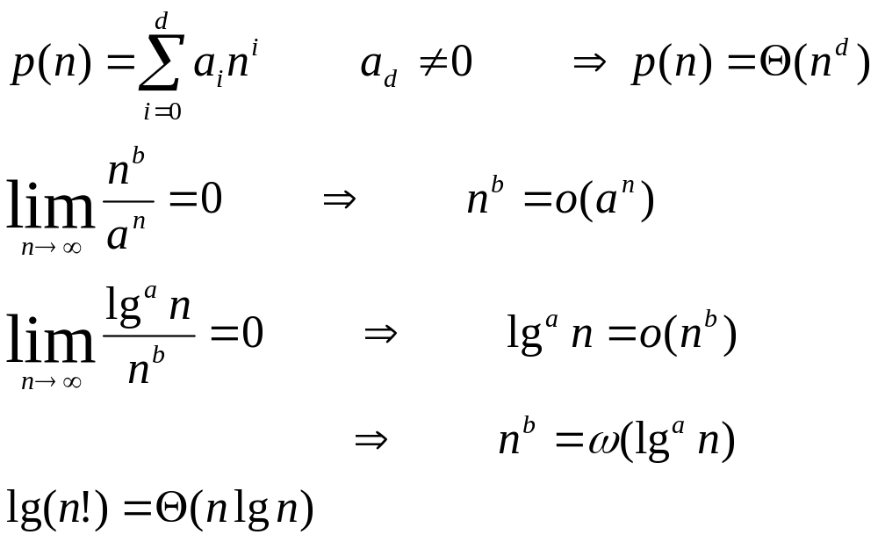
Notes on Functions

Slide 16
Examples

